Slide 1

Project Title :-
Build the model on Quality of wine.
Digambar Rajaram Sable
PGA - 34

Slide 2
Index :-
Introduction
Objective
Data Description
Source
Exploratory Data Analysis ( EDA )
Data Visualization
Data Partition
Model Building
Tree Build
Important Variable
Conclusion

Slide 3

Introduction :-
Today Wine is one of the most valuable drink in the world.
Wine can be made from grape, fruits, etc. Most wine is made from grapes.
There must be fermentation, that is sugar must be transform into alcohol. If the amount of alcohol is relatively low, the result is wine.
The majority of wine production is in two states which are Maharashtra and Karnataka.
If you drink the wine in limit then it will good for Heart.

Slide 4
Objective :-
The main objective of this project is to build model that can accurately analyse the Type of wine.
Sub-objective :-
To visualize and exploratory data Analysis
To determine the which model is analyse the accurate type of wine.

Slide 5

Data Description :-
This Dataset contains the product which are used when it will be made
volatile acidity : Volatile acidity is the gaseous acids present in wine.
fixed acidity : Primary fixed acids found in wine are tartaric, succinic, citric, and malic
residual sugar : Amount of sugar left after fermentation.
citric acid : It is weak organic acid, found in citrus fruits naturally.
chlorides : Amount of salt present in wine.
free sulfur dioxide : So2 is used for prevention of wine by oxidation and microbial spoilage.
total sulfur dioxide
pH : In wine pH is used for checking acidity
density
sulphates : Added sulfites preserve freshness and protect wine from oxidation, and bacteria.
alcohol : Percent of alcohol present in wine.
Source :-
website :- www.Kaggle.com

Slide 6
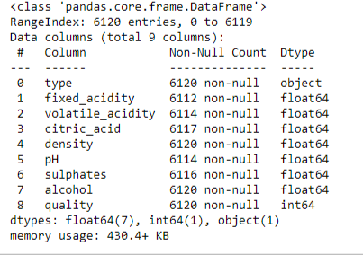
Exploratory Data Analysis (EDA) :-
I) Summary of Dataset
dig (a) :- Data Info

Slide 7
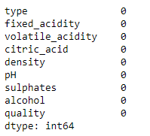
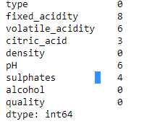
II) Null Values :- Null values are present it will be replace using mean() -
Replacing the Value
dig (b) :- Before replacing
dig (c) :- After replacing

Slide 8
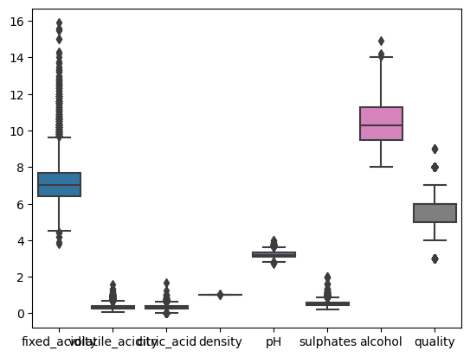
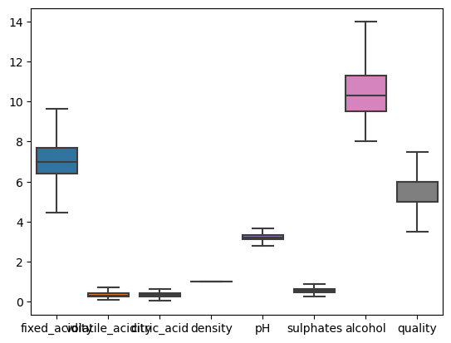
III) Outlier :-
In the dataset I have use boxplot to check the outlier. There is present the outlier then I have remove it by using winsorizing technique i.e. IQR .
dig (d) :- Before removing outlier
dig (e) :- After removing outlier

Slide 9
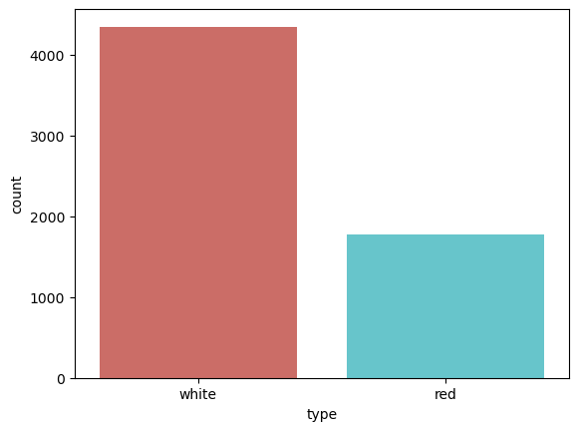
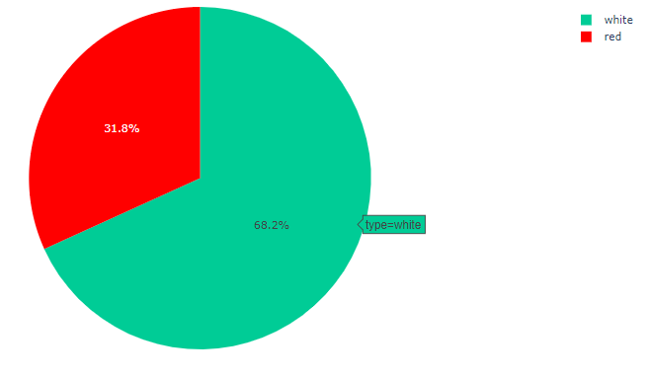
Data Visualization :-
Data visualize using Box plot, Pie chart, Bar plot and count plot
dig (g) :- Data Visualize using Pie Chart
dig (h) :- Data Visualize using Histogram

Slide 10
Data Partition :-
Data
(Wine types)
Train (70%)
Test (30%)
dig (j) :- Data Partition
In the above dig (j) there is train data to built the model and on test data we check the performance of model.

Slide 11
Model Building :-
Logistic Regression
(92/92 %)
Decision Tree
( 88 / 87 % )
Random Forest
(89/89%)
dig (l) :- Model Building

Slide 12
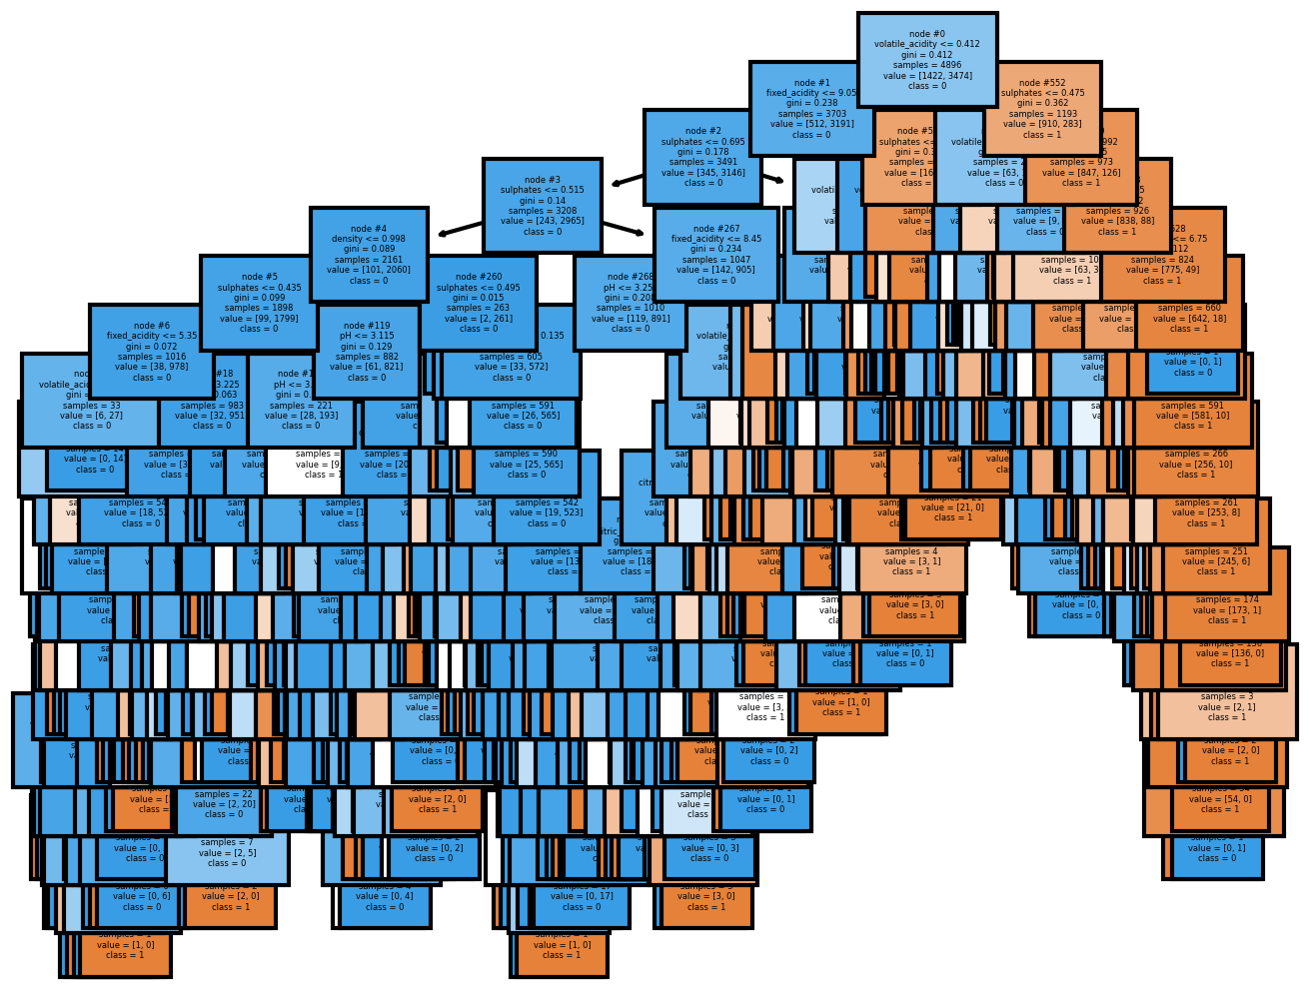
Trees Visualize:-

Slide 13
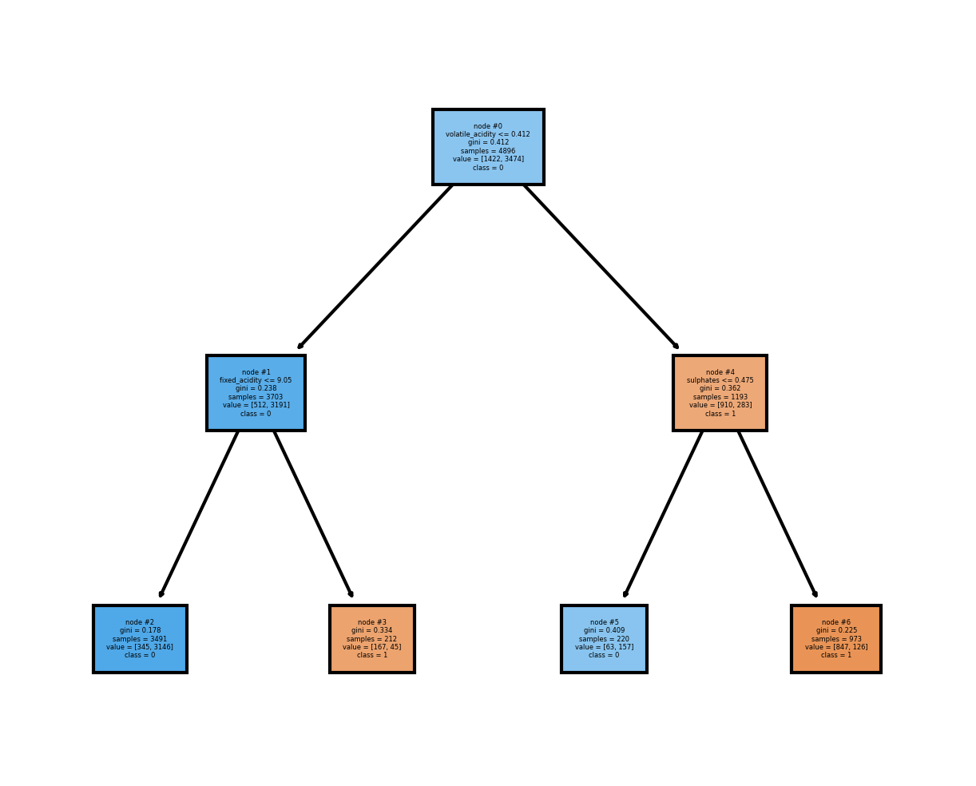
Trees Visualize:-

Slide 14
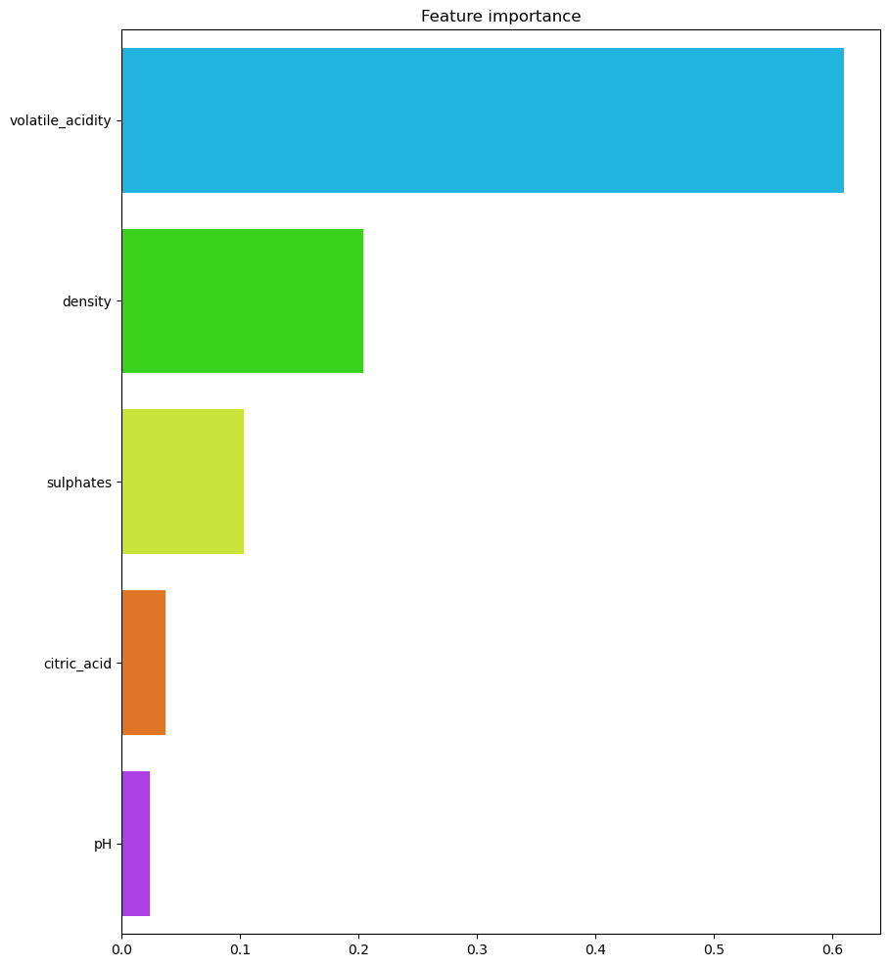
Important Variable :-
In the dataset Volatile Acidity is the important variable as compare to other variable.
Volatile Acidity is depend sulphate, density, citric_acid, ph.

Slide 15
Conclusion :-
EDA -
White wine is mostly used as compare to red wine.
Model:-
Able to predict 92 % Accuracy ( Logistic Regression )
Sensitivity of wine Capture by Model is 83 %
Specificity of wine Capture by Model is 94 %

Slide 16

Thank You …!!

